Slide 1


Bridging Regions:
Caucasus Pathway to Global Connectivity for Central Asia
Thomas Mazejian
Principal Consultant @Wireless 20|20
https://wireless2020.com

Slide 2


Principal Consultant at Wireless 20|20 delivering valuable insights to telecom clients and helping them on their transformation journey.
Ex Chief Information Officer of Viva-MTS, the Armenian subsidiary of the Russian mobile operator Mobile TeleSystems (MTS) from July 2007 to January 2024
Co-founded several startups, including DC Soft one of the leading Lebanese software development companies specializing in billing systems solutions.
Founded and current president of PMI Armenia Chapter, which promotes project management and agile practices in Armenia.
BANA angel investor and believer in Armenian startup potential
Founder and general manager of Smart Rapid Growth FZ LLC
Master’s of Science degree in Information Systems with specialization in AI and big data analytics from the University of Salford, Manchester, United Kingdom
20+ certifications holder including PMP, Disciplined Agile Senior Scrum Master (DASSM), Disciplined Agile Coach (DAC), Disciplined Agile Value Consultant (DAVSC), OKR certified professional (OKRCP), ATP Instructor
My mission: Linking technology with business by aligning the IT strategy with the company's mission, values and strategic objectives. Focusing always on business results, time to market and organizational agility.

Slide 3
Abstract
In an era where digital connectivity drives economic growth and geopolitical influence, the Republic of Armenia stands at a strategic crossroads with the potential to serve as a pivotal link between Central Asia and Europe.
This presentation explores the technical feasibilities, geopolitical implications, and economic benefits of developing a robust fiber optic network to interconnect these regions through Armenia.

Slide 4

About Wireless 20|20
We work hand in hand with your technology, marketing and product teams providing you with on-the- ground knowledge to make informed decisions and develop defensive or offensive strategies. Our extensive market experience, in-depth technical knowledge, and global industry contacts enable your company to maximize business opportunities in this multi-billion dollar market.
Consulting/Expert Advise
Business Case Development
Technology Strategy
Market Strategy
Partnership Development
Spectrum
Fiber, Wireless & Mobile Broadband
Network and Business Planning

Slide 5
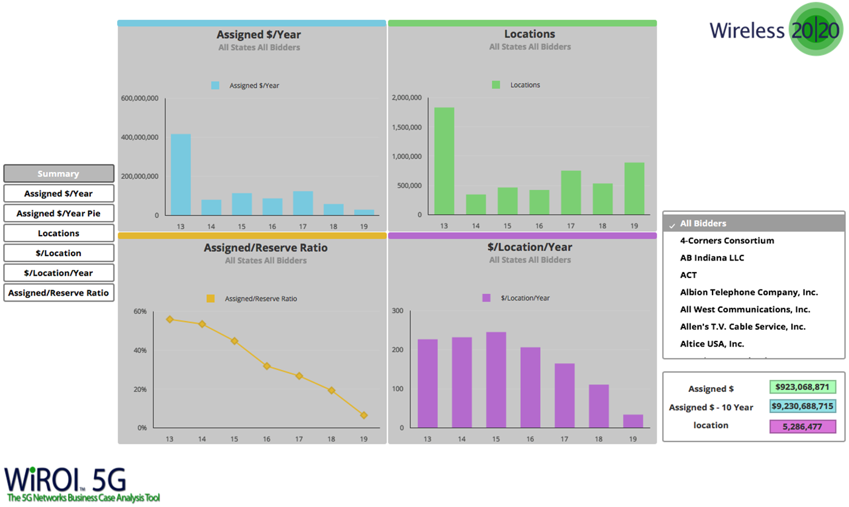
About Wireless 20|20
WiROI™ 4G LTE Business Case Analysis Tool
WiROI™ 5G Business Case Analysis Tool
WiROI™ IoT Business Case Analysis Tool
WiROI™ db Geospatial SaaS Platform
WiROI™ Neutral Host Networks Venue Business Case Analysis Tool
WiROI™ Venue Business Case Analysis Tool
WiROI™ Wi-Fi Offloading Business Case Analysis Tool
WiROI™ RDOF Lite Business Case Analysis Tool

Slide 6

Digital Connectivity: The Backbone of Nations
Digital connectivity refers to the ability to access and use information and communication technologies (ICTs), such as the internet, mobile phones, and computers.
Digital connectivity is no longer a luxury but a necessity for nations to thrive in the 21st century.
It is the foundation for a digital society, enabling individuals and businesses to connect, communicate, and collaborate seamlessly.
Digital Connectivity is a catalyst for progress, innovation, and inclusive development.

Slide 7
Digital Connectivity: Why is it Crucial?
Economic Growth: Digital connectivity fuels innovation, entrepreneurship, and e-commerce, boosting economic growth and job creation.
Education and Healthcare: Online learning platforms and telemedicine expand access to quality education and healthcare, especially in remote areas.
Government Efficiency: Digital services improve government efficiency, transparency, and citizen engagement.
Global Competitiveness: A strong digital infrastructure attracts foreign investment and positions a nation as a leader in the global economy.
Social Inclusion: Digital connectivity empowers marginalized communities and bridges the digital divide.
Crisis Management: Reliable communication networks are vital for disaster response and recovery.

Slide 8
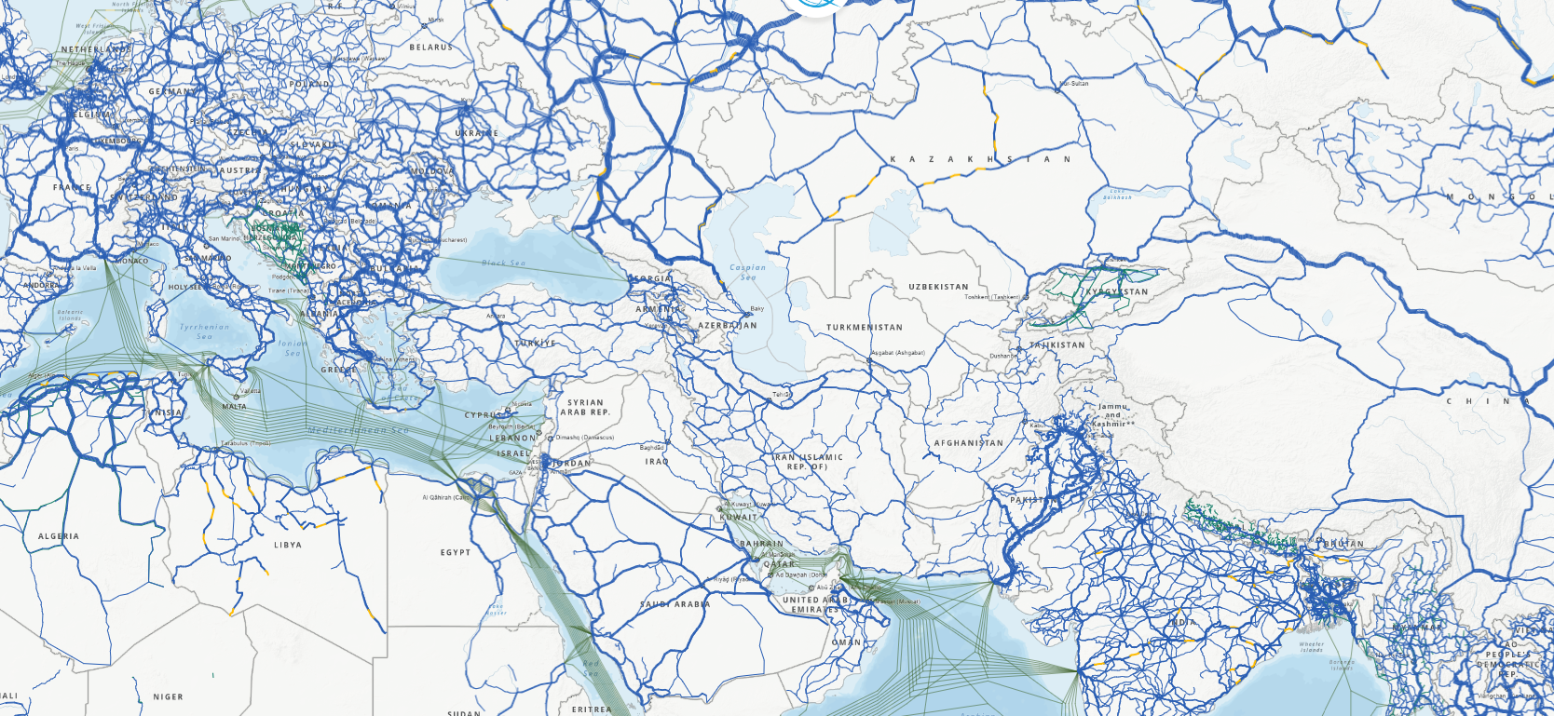
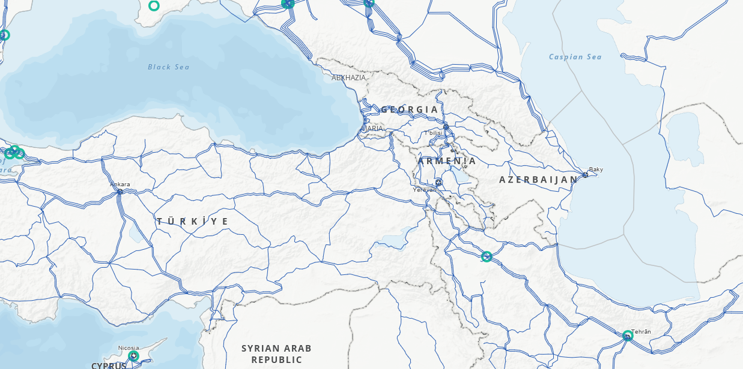
Infrastructure Fiber Optic Map: Central Asia to Europe
Source: ITU
Notes:
South North FO Backbone interconnection point on the south border is near Agarak interconnected with TIC, which is extended to Georgia border interconnection points in Bagratashen/Sadakhlo or Tashir/Gogavan interconnected with FOPTNET, SILKNET and Caucasus Online. DWDM technology is in place with x100Gs. The whole path is fully redundant by FO rings.

Slide 9
Infrastructure Fiber Optic Map: Central Asia to Europe
Source: ITU

Slide 10
Why Armenia: Technical Feasibilities
Existing Fiber Optic Networks: Armenia already has a well-developed telecom infrastructure, with multiple fiber optic lines connecting it to neighboring countries. These include connections to Georgia, which in turn links to European networks, and Iran, providing a gateway to the Middle East and South Asia.
Bandwidth Capacity: Armenia's current bandwidth capacity is substantial, with further potential for expansion. The country’s backbone network supports high-speed data transmission, which is crucial for international data traffic.
Armenia-Iran Fiber Optic Link: The Armenia-Iran fiber optic link is a critical asset that not only enhances bilateral connectivity but also positions Armenia as a key player in the regional telecom landscape. This link provides an alternative route to bypass the more congested routes through Turkey and Azerbaijan.
Modern Data Centers: Armenia is home to several modern data centers, including OVIO’s Tier 3 data center, which offers reliable and secure hosting services. These facilities are vital for supporting international internet traffic and ensuring low latency for users across different regions.
Edge Computing: Google Global Cache, Facebook Network Acceleration, Cloudflare, Tiktok, CDN77, Microsoft Connected Cache, NGENIX CDNS, Gcore, and Rutube

Slide 11
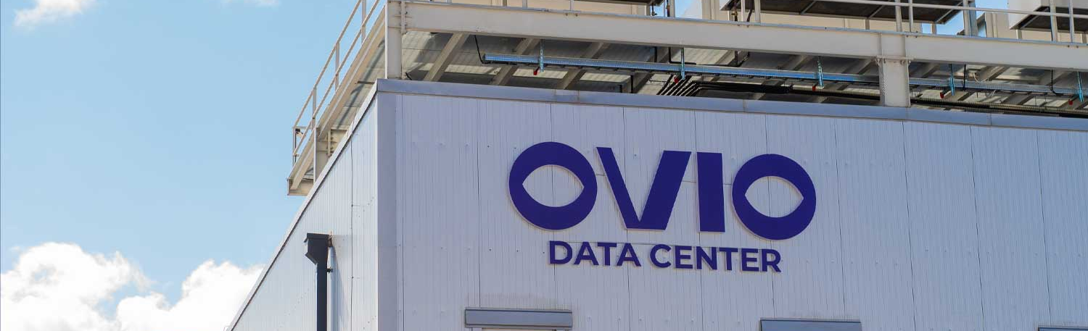
OVIO Tier 3 Data Center
200 racks for collocation
Ovio Cloud and gCloud, public and private cloud solutions based on VMWare
Several thousand CPU cores available, with terabytes of storage.
Enterprise grade Storage and Backup capacities available to a customer.

Slide 12
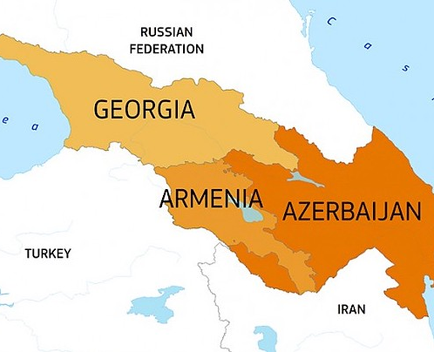
Why Armenia: Geopolitical Implications
Central Hub: Armenia is uniquely positioned at the crossroads of Europe and Asia, making it an ideal hub for digital and physical connectivity. Its location allows for shorter and more direct routes for data transmission between the two continents.
Proximity to Key Markets: Armenia is in close proximity to key regional markets, including Russia, Iran, Turkey, and the broader Middle East. This proximity enhances its value as a central point in a transcontinental digital infrastructure.

Slide 13
Why Armenia: Economic Value
Stable Environment for Investment: Despite regional challenges, Armenia has maintained a relatively stable political and economic environment, making it an attractive destination for foreign investment in infrastructure projects.
Government Support: The Armenian government has shown strong support for the ICT sector, with initiatives aimed at fostering innovation and improving the country’s digital infrastructure. This support is crucial for the successful implementation of large-scale projects like regional fiber optic networks.
Cost-Effective Operations: Armenia offers a cost-effective environment for technology and infrastructure projects, with lower operational costs compared to neighboring countries. This economic advantage makes it a favorable location for companies looking to establish or expand their regional presence.
Skilled Workforce: Armenia boasts a highly educated and skilled workforce, particularly in the fields of engineering and information technology, which is essential for maintaining and expanding the fiber optic network.

Slide 14
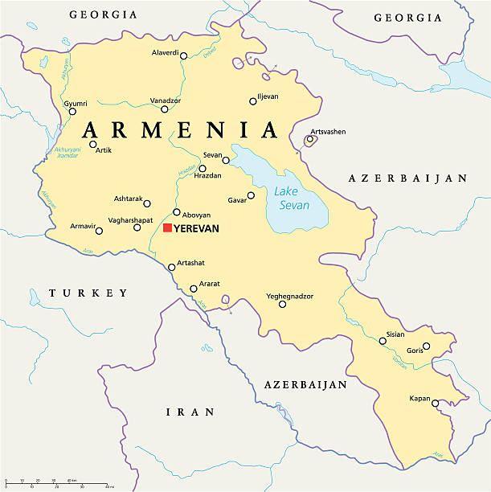
Why Armenia: Conclusion
By serving as a key transit point for data between Europe and Asia, Armenia stands to benefit from increased data traffic, which can lead to greater economic growth. Global data traffic is expected to grow by 25% annually, and Armenia's strategic position could capture a significant portion of this growth.
Armenia’s unique geographic location, robust infrastructure, technological capabilities, and supportive economic environment make it an ideal candidate for bridging regions through fiber optic connectivity.
By leveraging these strengths, Armenia can play a pivotal role in the future of global digital communications.

Slide 15
Thank You
LinkedIn: linkedin.com/in/viewthomas/
Email: thomas@wireless2020.com
Website: www.wireless2020.com

